Slide 1
Company Intro
  Wolters Kluwer Overview
  CCH Tagetik at a glance
  Industry leadership
  Analyst, Customer & Partner Recognition
  Common FUD
  Strengths & Weaknesses

Slide 2
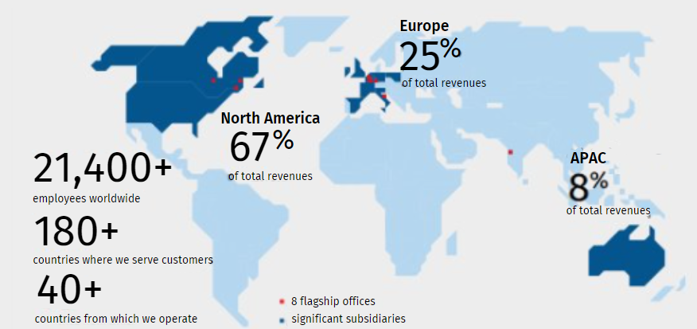

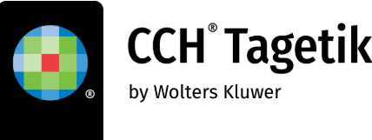

$6.1B publicly traded global provider of Software Solutions with consistently solid financial results
Within Wolters Kluwer, the CCH Tagetik solution focuses on providing an Intelligent Finance Transformation Platform powered by Artificial Intelligence for the office of the CFO
2024 Revenue Type
$
Recurring 82%
Non-recurring 18%
2300+
customers
2000+
certified partners
4.8/5
Gartner Peer Insights
20+
Years of experience
Notes:
Wolters Kluwer is a publicly-traded global organization headquartered in the Netherlands, providing expert solutions that combine deep domain expertise with the latest and most modern technologies.
We are recognized for consistently delivering solid financial results while empowering professionals worldwide. Our global footprint is vast. We have over 20K employees worldwide who serve customers in more than 180 countries with NA being the biggest region of operation for Wolters Kluwer.
We are a financially robust organization with around $6B in revenues, of which more than 80% are recurring, providing us with stability and predictability year after year.
2023 was another year of strong performance. We achieved 6% organic and PROFITABLE growth with a solid balance sheet and cash flow position. Notably, 58% of our revenues come from expert solutions, like CCH Tagetik, reinforcing our focus on providing high-value, specialized offerings.
Within Wolters Kluwer, CCH Tagetik is the flagship solution serving the Office of the CFO. As global leader in Corporate Performance Management, we offer an Intelligent Platform powered by AI to help Finance professionals globally with their Close & Consolidation needs, Budgeting & Planning efforts and also their Tax and Regulatory requirements such as ESG, Annual Report and the Qs and the Ks.
With a presence spanning the globe, we have more than 1100 employees servicing more than 2300 customers worldwide across more than 15 industries, from manufacturing to financial services With over two decades of experience, we have become a trusted partner for businesses seeking to drive transformation and achieve financial and operational excellence.
We do recognize that CCH Tagetik might be less known in NA than other vendors, so let me spend maybe a few seconds explaining how we operate specifically in NA.

Slide 3

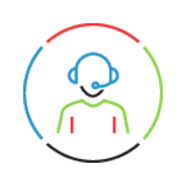
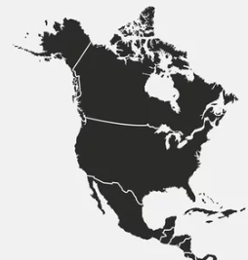

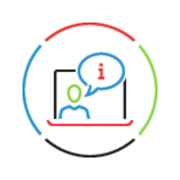

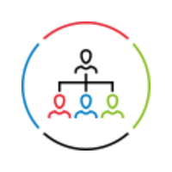
CCH Tagetik NA Fact Sheet
Headquartered in NYC
Local Support Centers in CT, NC, IL, TX and Canada
Local Customer Success Management
Local Services Center of Excellence
Continuous education via Learning Hub
Global CCH Tagetik Executive Team based in North America
Notes:
In North America, our main office is located in the Financial District of New York City, but our reach extends far beyond. We leverage multiple office locations across the U.S. and Canada, with direct staff in more than 20 states to ensure comprehensive coverage and local expertise.
We take great pride in our extensive local presence, which is key to delivering exceptional customer support and satisfaction. Our local support centers in Connecticut (CT), North Carolina (NC), Illinois (IL), Texas (TX), and Canada, along with our EMEA and APAC support centers, provide follow-the-sun global coverage. This means that whether you need assistance within North America or beyond, we ensure continuous, reliable support.
Additionally, our Customer Success Managers are local professionals who stay with you throughout your implementation—and more importantly, beyond—to ensure long-term success.
To further enhance implementation quality, we have a dedicated Center of Excellence (CoE) in North America. This team is focused on tackling complex project challenges, ensuring quality assurance, and providing strategic design recommendations. The CoE maintains a direct line of communication with our Global Product Management and Product Development teams overseas, ensuring that our solutions evolve in alignment with customer needs. This center also serves as a key resource for our partners, equipping them with the expertise needed for successful project execution.
Another critical aspect of our North American operations is our local Training Academy, a dedicated team committed to empowering users with a structured learning experience. We offer a variety of learning paths, ranging from foundational training for new users to advanced courses designed for expert-level proficiency.
Finally, our Global Divisional CEO, Karen Abramson, is based in North America, along with several other key global executives. Many of our global functions, including Alliances and Product Marketing, are also managed from North America, reinforcing our region’s strategic importance.
Working with us you will notice that our approach to the North American market is fundamentally different from the competition. We are not a “growth-at-all-costs” organization; instead, we prioritize profitable growth and long-term sustainability. Our focus remains on product innovation rather than excessive marketing investments, ensuring that we continue to deliver real value to our customers.
This strategy is paying off, as evidenced by the large and growing community of North American customers who have chosen us as their trusted partner for Finance Transformation.
NEXT SLIDE

Slide 4

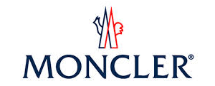


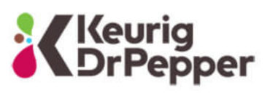






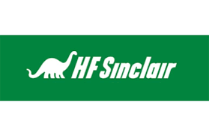



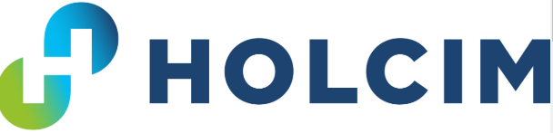






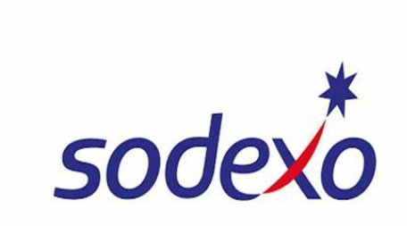

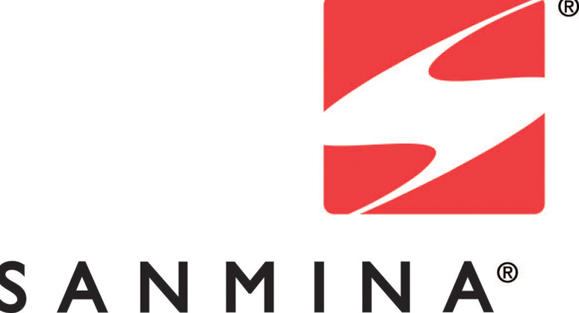








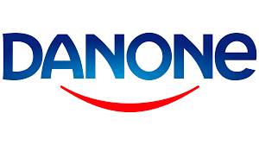


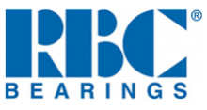



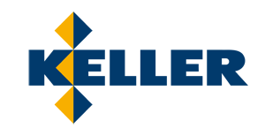






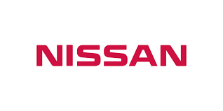






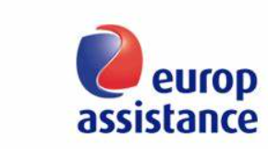


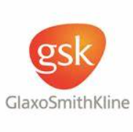


























Inspired by a community of growing customers
Selection of NA Customers
Selection of Global Customers
4
Notes:
In NA we serve organizations of all sizes and industries, from smaller businesses to North American household names like Keurig Dr Pepper, Halliburton, and Milwaukee Tool, as well as global giants such as Toyota and Danone.
While we don’t focus on any single sector, we have a strong presence in manufacturing, followed by industries like professional services and energy—areas that often face significant complexity, which our solutions are designed to address and simplify.
Regardless of size or industry, our customers share a few common traits:
Many initially adopt CCH Tagetik to address a specific need but later expand its use to areas they hadn’t even considered during the initial software selection process.
They consistently express satisfaction with the functionality and support we provide, reflected in our status as having the highest Net Promoter Score in the industry.
Their feedback and new requests are invaluable in driving our continuous improvement. Some even play an active role on our Global Customer Board, shaping the future of our solutions together.
When we serve these customers, we usually to so in collaboration with a strong netrwork of alliances that are certified to implement our solutions – NEXT SLIDE

Slide 5






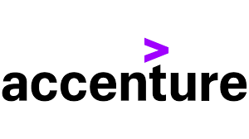







Supported by certified industry & technology experts
Technology Partners |  |  | System Integrators |  |  |  |  | NA Boutique Specialists
Providers of scalable cloud infrastructure and/or advanced services to enhance CCH Tagetik’s capabilities |  |  | Providers of expert advisory services and system integration to optimize CCH Tagetik’s solutions for seamless business transformation. |  |  |  |  | As providers of expert implementation services, boutique partners specialize in tailoring and optimizing CCH Tagetik solutions to meet unique business needs ensuring on-time and on-budget implementations
Notes:
With over 2000 certified partner consultants, we collaborate with different types of organizations to amplify our impact:
Technology vendors such as Microsoft, Amazon, and even SAP co-innovate with us to enhance the capabilities of our solutions and push the boundaries of innovation. Their collaboration ensures that CCH Tagetik remains at the forefront of technology and continues to deliver unmatched value to our customers.
System Integrators and Big Four advisory firms partner with us, recognizing the powerful potential of the CCH Tagetik platform to drive finance transformation initiatives for their clients. These partnerships extend our reach and help businesses achieve their strategic objectives with confidence.
Boutique consulting firms like Huron and Breakaway Technologies recognize CCH Tagetik’s superiority over legacy solutions and work closely with us to deliver tailored implementations and exceptional results for their customers. Their specialized expertise, combined with our cutting-edge technology, ensures that organizations of all sizes can unlock their full potential.
These alliances, play a crucial role in extending our reach and allowing us to deliver transformative solutions to our customers worldwide
However, not just what we say about us, but also external sources recognize CCH Tagetik as a leader and NA firms such as BPM Partners recognize our supremacy locally versus better known vendors here in NA. NEXT SLIDE

Slide 6
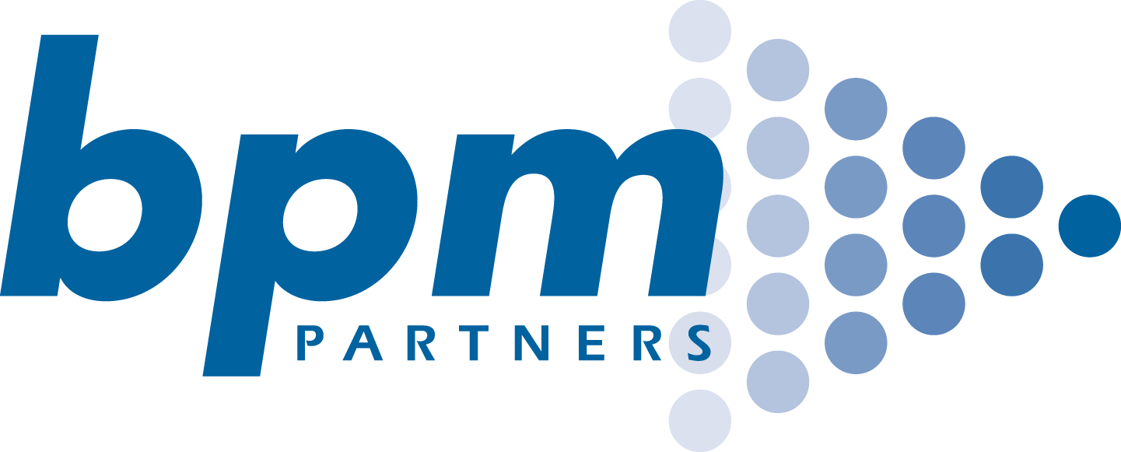


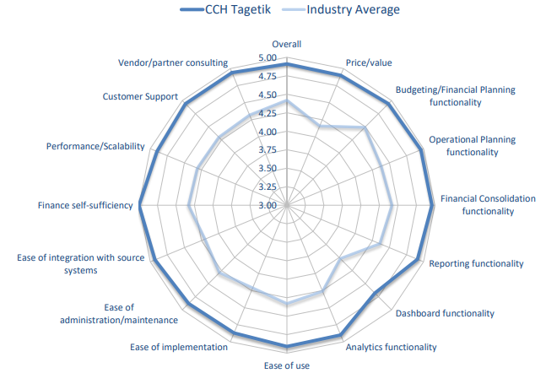

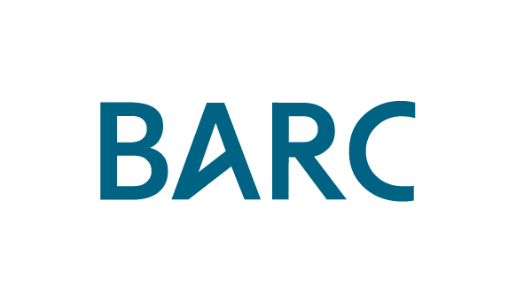
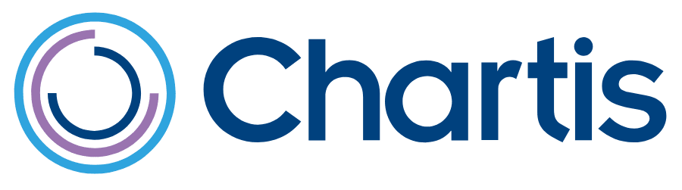

Recognized by all major NA & Global industry analysts
Leader
Leader
Leader
Premier Leader
Leader – MQ Financial
Planning and MQ Financial Close & Consolidation - 2024
Customers Choice – Financial Planning 2024
CPM Value Matrix – Feb 2024
SCP Value Matrix – Mar 2024
EPM – Jun 2024 Overall
leader with perfect recommend score
ESG – Jul 2024 Tied for 1st
FCCR – Oct 2024 1st place
Leader
Leader
Leader
Financial Consolidation,
Financial Performance Management – Mar 2024
RiskTech Quadrant® for IFRS 17 compliance solutions and LDTI solutions – Mar 2022
Green Quadrant ESG Reporting and Data Management Software – July 2023
6
Vendor Landscape Matrix – July 2024
27 april 2025
Notes:
The analyst community holds CCH Tagetik in high regard, with recognition from Gartner, Nucleus Research, BARC, BPM Partners, and others, consistently positioning us as an industry leader.
While you’ve likely seen similar slides in competitors’ presentations, let me share a couple of unique anecdotes:
We’ve maintained a leading position in Gartner’s rankings for six consecutive years.
In North America, BPM Partners created a brand-new category in their Vendor Matrix. report, the ‘Dominant Category,’ to reflect how significantly CCH Tagetik outperformed the competition. You can see we outperform the industry average on every key customer satisfaction criteria from ease of use, to performance, customer support, etc
The one main aspect that our customers, partners and analysts appreciate the most of CCH Tagetik both locally and globally is our maniacal obsession for innovation in the office of the CFO. In the past 2 decades of operation, we have pioneered numerous industry firsts - NEXT SLIDE

Slide 7



A long history of “firsts” & innovation for the CFO office
1st CPM vendor with a platform, one database and a one application approach
1st to offer prepackaged applications
1st with Analytic Information Hub for granular financial and operational data
1st with Finance-forward Supply Chain Planning
1st with Global Minimum Tax –
Tax planning
2008
2012
2013
2014
2018
2020
2021
2022
2023
2024
1st to support integrated business and financial planning; 1st for time-dependent hierarchies in all dimensions
1st on premises CPM vendor to provide a cloud solution
1st for AI-based ‘explainable’ predictive intelligence
1st for ESG & Sustainability Performance Management
1st for AI-powered Intelligent Platform
Notes:
I won’t cover every milestone here but will focus on the most significant ones.
In 2008, we pioneered the concept of a unified platform, recognizing the importance of delivering a single version of the truth for both actual and budget data.
In 2014, we became the first—and remain the only—CPM solution to run natively on SAP HANA, even before SAP itself could deploy its CPM solutions on its own HANA database.
In 2018, we were the first to identify the convergence of financial and operational data, leading to the development of our Analytical Information Hub (AIH). This data hub was specifically designed to host massive amounts of operational data, bridging the gap between financial and operational insights.
More recently, leveraging the power of our very own AIH, we introduced groundbreaking solutions to minimize risk and enhance compliance. These include Supply Chain Planning in 2021, Sustainability and ESG Reporting in 2022, and Global Minimum Tax in 2023.
Most recently, 2024 marked a pivotal moment by being the first vendor to integrate Artificial Intelligence pervasively across our platform, enhancing data accuracy and productivity throughout our applications.

Slide 8
3 reasons why this matters to you:
Wolters Kluwer and its finance-leader solution CCH Tagetik is a trusted partner for your organization:
1
Robust financials and reliable reputation from years of transparent and accountable operations
2
Maniacal obsession with R&D and product innovation to increase customer productivity
3
Global presence with localized NA support ensures our customers benefit from world-class innovation and expertise while receiving dedicated support
Notes:
We’ve covered a lot so far, but I want to leave you with the top three takeaways about who we are at Wolters Kluwer:
First, we are a stable and financially solid organization with no exit strategy in sight. We are here for the long term. Our robust financial foundation and longstanding reputation for transparency and accountability provide our customers with the confidence that they are partnering with a stable, trustworthy and dependable company for the long term.
Second, we have an unwavering commitment to innovation. Our maniacal focus on research and development ensures that we continuously deliver cutting-edge solutions designed to enhance customer productivity and address the evolving needs of modern finance teams. The word ‘legacy’ simply doesn’t exist in the CCH Tagetik vocabulary—we’re always moving forward.
Third, and most importantly, Wolters Kluwer CCH Tagetik combines the strength of a global organization with the agility of a localized presence, ensuring that customers benefit from world-class innovation and expertise while receiving dedicated, region-specific support. In North America, we operate as a fully functional entity, with local teams for support, implementation, training, and customer success, providing hands-on guidance throughout every stage of your finance transformation journey.
These three pillars—stability, innovation, and expertise—are what make Wolters Kluwer and CCH Tagetik the trusted choice for over 2,300 organizations worldwide

Slide 9
Common Questions & Competitive FUD
We have never heard of Tagetik before
I understand and agree that we may not be the biggest name in the market, especially here in the US. Our approach is different—we prioritize R&D over massive marketing campaigns. The reality is that we’re trusted by over 2,300 customers globally and consistently recognized as leaders in the industry by Gartner and other analysts but yes, for sure we do have the same level of awareness that Oracle or SAP have.
Are you a US based company? We hear that you are mostly based in Italy
CCH Tagetik is part of Wolters Kluwer, a global company headquartered in the Netherlands, with a significant presence in North America (64% of our revenues comes from NA). As CCH Tagetik, our roots are in Italy, where our R&D and product innovation teams are based. Here in the US have a strong and fully staffed operation, including sales, consulting, and customer support, to ensure we're closely aligned with our North American customers. You will be calling NA people and not offshore staff in India or Europe.
How many customers do you have in NA?
We have approximately 300 customers in the US, spanning every industry, with a strong presence in manufacturing. Our customer base includes household names like Keurig Dr Pepper, the NHL, and Franklin Milwaukee Tool, as well as smaller organizations like Members 1st and the Rockefeller Foundation. Regardless of size or industry, our customers typically begin their transformation journey by addressing a specific need, such as consolidation or HR planning, and then expand into other areas of the application as their needs evolve."

Slide 10
Thank You

